Slide 1
Demo scenario 1

Slide 2
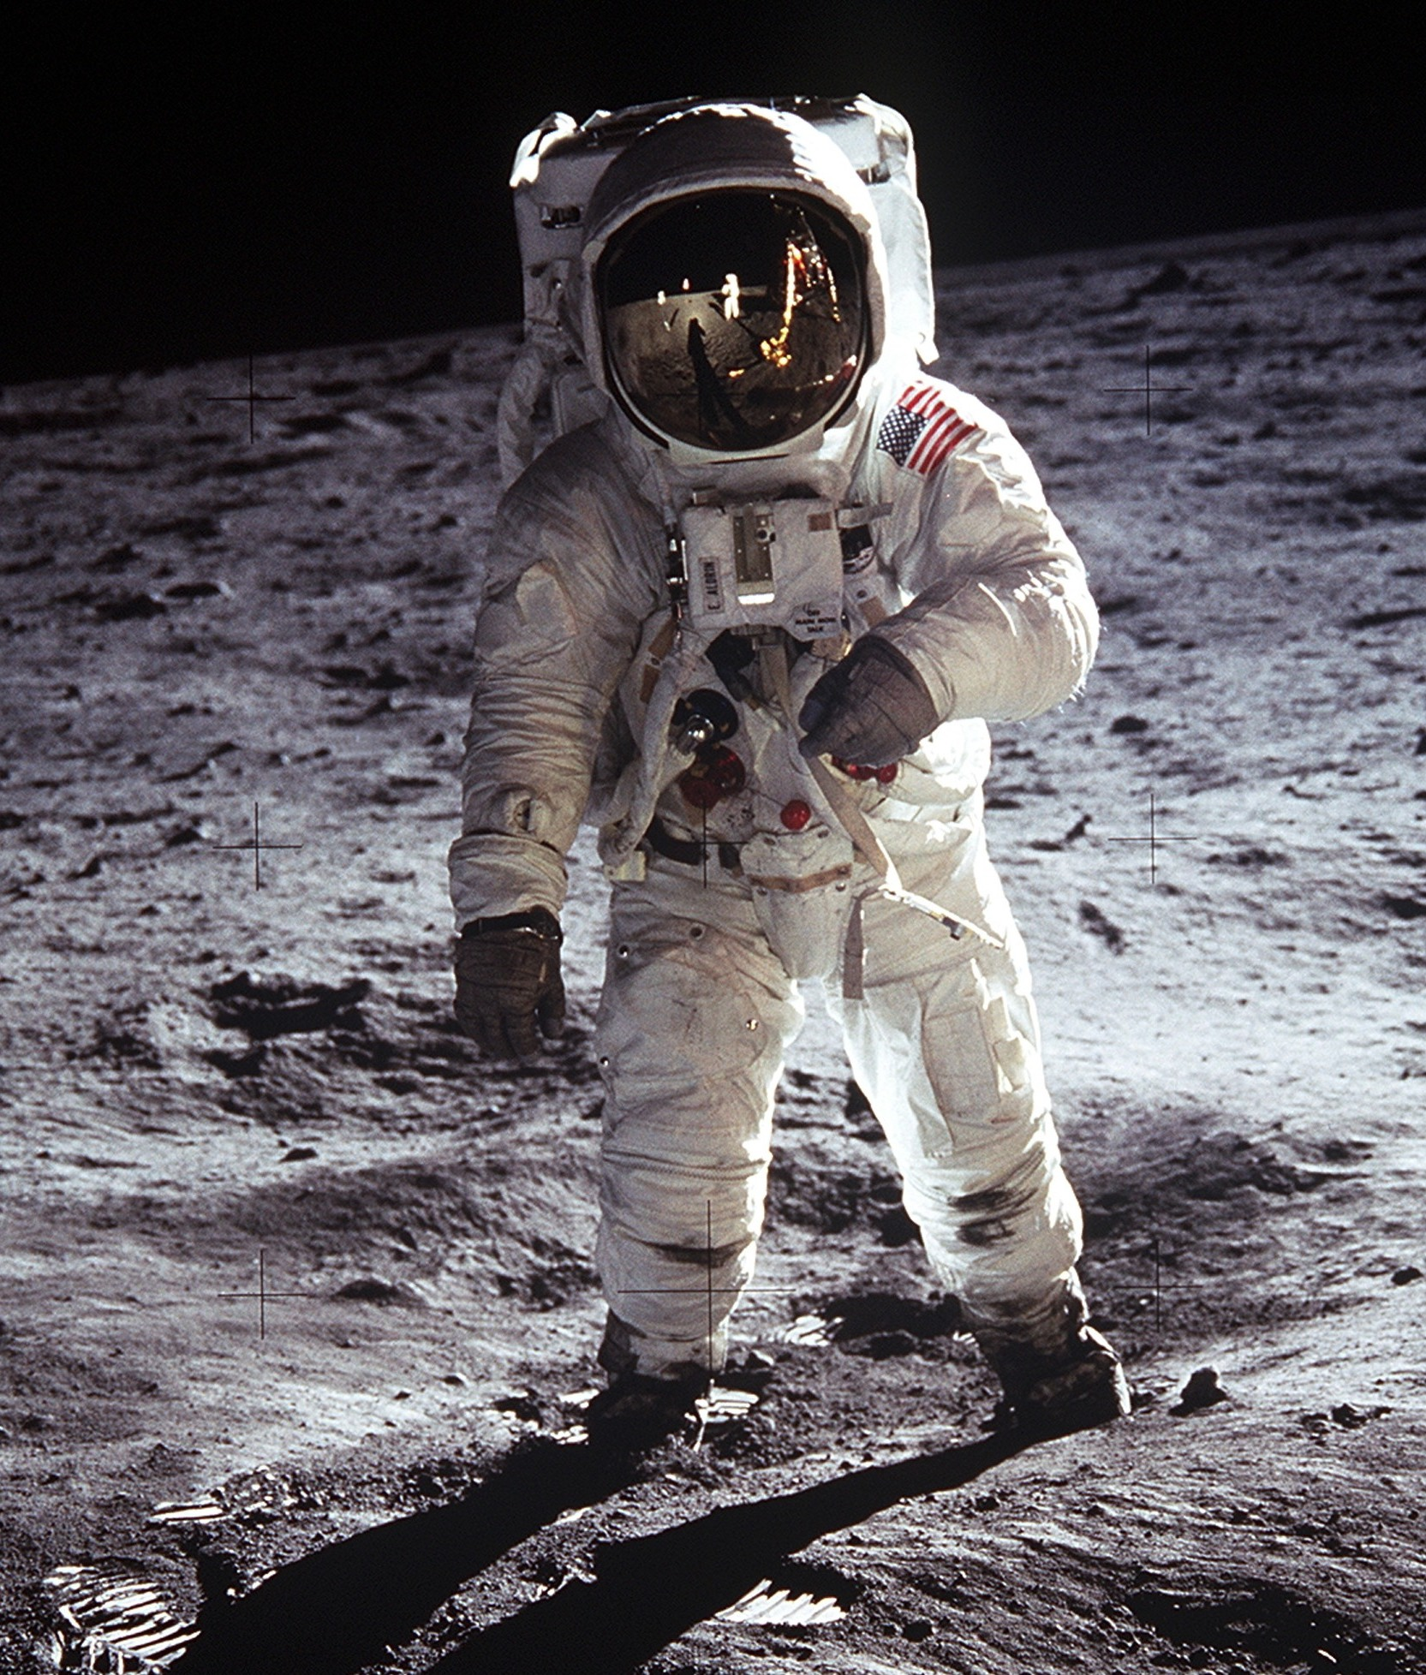
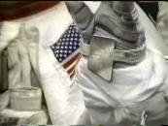
1st：Conventional way to contrcol temperature etc...
1
astronaut health is monitored by control center
2
using mirror to see and control these instruments to control astronauts health
Oxygen level
Inner Pressure
Temperrature

Slide 3
2nd：Show new display image
Check !!
Oxygen level
temperature
Task1
Task2
…
..
heart beat
inner pressure

Slide 4
3rd：Show image from camera
control dial by yourself watching display
camera
Image from camera
change

Slide 5
Demo scenario 2

Slide 6
communicate with control center

Slide 7
communicate with Bluemix

